Slide 1
Change-Making Problem
Truong Quang Huy – ID: 18602
CS2019 - VGU

Slide 2
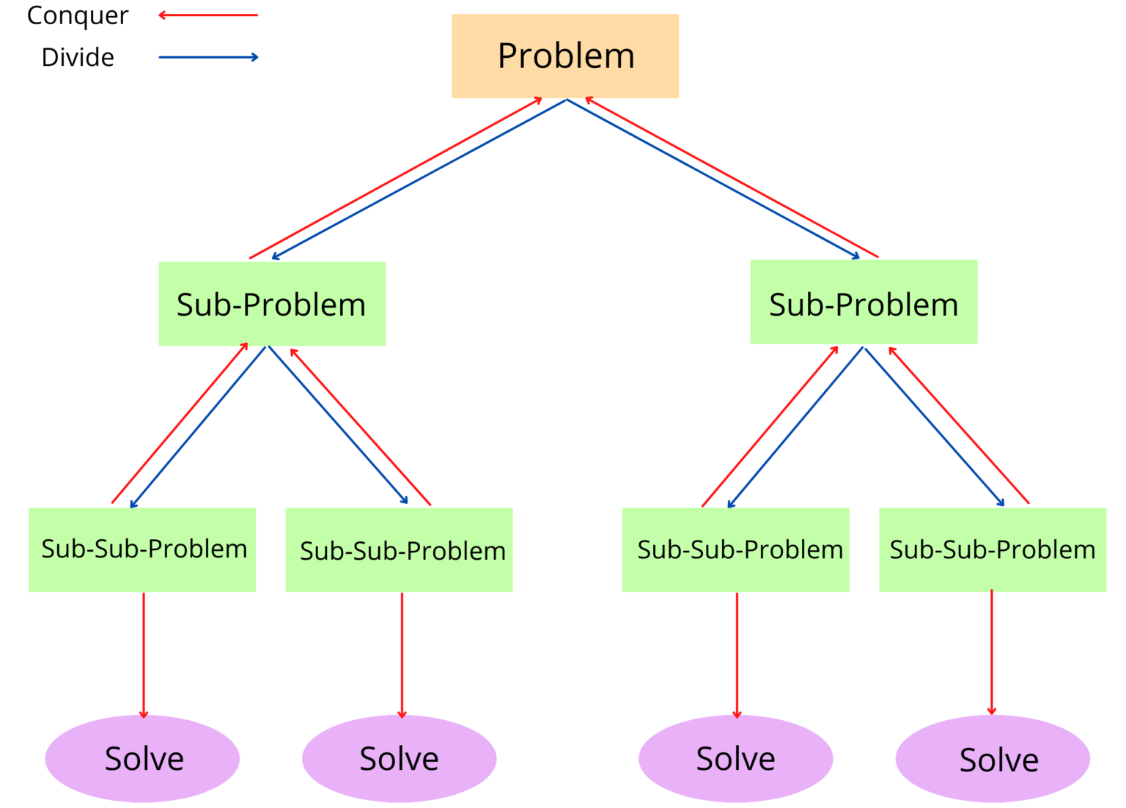
Divide and Conquer

Slide 3
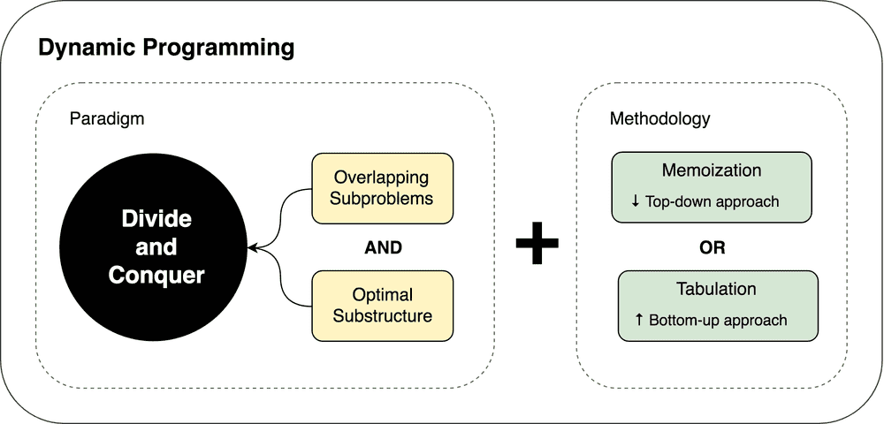
Dynamic Programming

Slide 4
4 steps of problem solving with dynamic programming
Characterize the structure of an optimal solution
Recursively define the value of an optimal solution
Compute the value of an optimal solution
Construct an optimal solution from the computed information

Slide 5
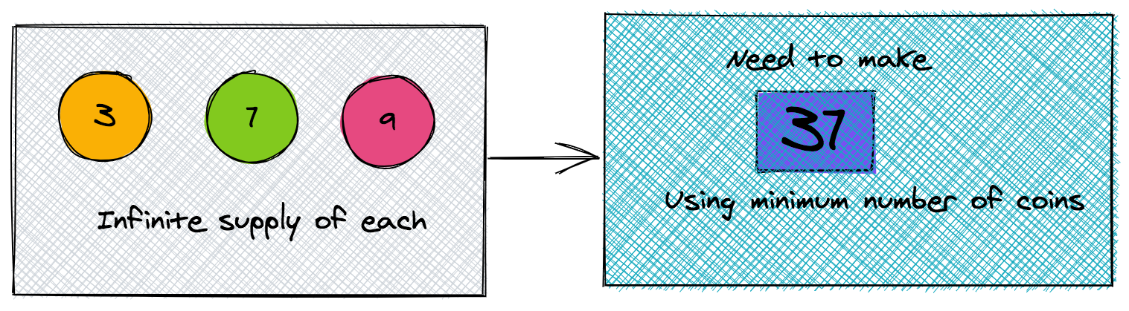
Change-making problem

Slide 6
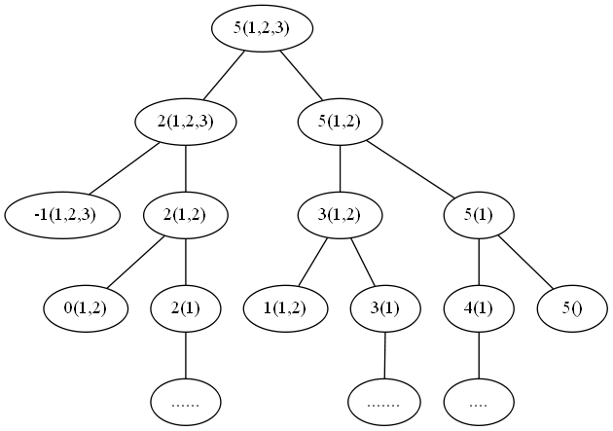
Step 1: Recursive Tree
use
don’t use
3(1)

Slide 7
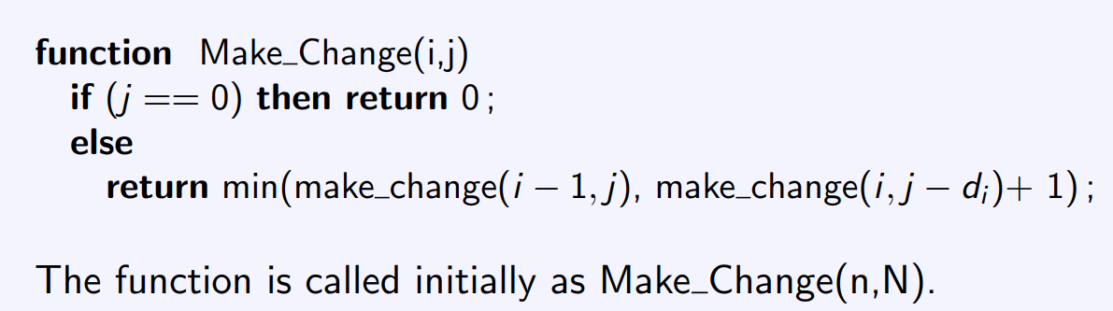
Step 2: Recursive function
To compute the value of Make_Change(i, j):
Don’t take a coin i -> Make_Change(i – 1, j)
Take a coin i -> Make_Change(i, j – d[i]) + 1
We take the minimum of these 2 value

Slide 8
Step 3: Compute and store the optimal subsolution
Assume n = 3, d₁ = 1, d₂ = 4, d₃ = 6, Let N = 8
Amount | 0 | 1 | 2 | 3 | 4 | 5 | 6 | 7 | 8
d₁ = 1
d₂ = 4
d₃ = 6

Slide 9
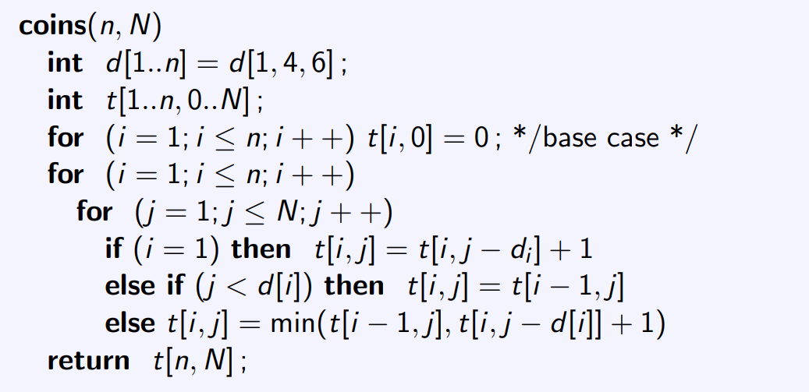
Fill in the table (Pseudocode)

Slide 10
Fill in the table (4 cases)
Base case: if (j == 0) then return 0
Amount | 0 | 1 | 2 | 3 | 4 | 5 | 6 | 7 | 8
d₁ = 1 | 0
d₂ = 4 | 0
d₃ = 6 | 0

Slide 11
Fill in the table (4 cases)
if (i == 1) then
t[i , j] = t[i , j – d_{i}] + 1 (only go left – Use)
Amount | 0 | 1 | 2 | 3 | 4 | 5 | 6 | 7 | 8
d₁ = 1 | 0 | 1 | 2 | 3 | 4 | 5 | 6 | 7 | 8
d₂ = 4 | 0
d₃ = 6 | 0

Slide 12
Fill in the table (4 cases)
if (j < d_{i}) then
t[i , j] = t[i - 1, j] (only go right – Don’t Use)
Amount | 0 | 1 | 2 | 3 | 4 | 5 | 6 | 7 | 8
d₁ = 1 | 0 | 1 | 2 | 3 | 4 | 5 | 6 | 7 | 8
d₂ = 4 | 0 | 1 | 2 | 3
d₃ = 6 | 0

Slide 13
Fill in the table (4 cases)
Else
t[i , j] = min( t[i - 1, j], t[i , j – d_{i}] + 1)
Amount | 0 | 1 | 2 | 3 | 4 | 5 | 6 | 7 | 8
d₁ = 1 | 0 | 1 | 2 | 3 | 4 | 5 | 6 | 7 | 8
d₂ = 4 | 0 | 1 | 2 | 3 | 1 | 2 | 3 | 4 | 2
d₃ = 6 | 0

Slide 14
Final table
Amount | 0 | 1 | 2 | 3 | 4 | 5 | 6 | 7 | 8
d₁ = 1 | 0 | 1 | 2 | 3 | 4 | 5 | 6 | 7 | 8
d₂ = 4 | 0 | 1 | 2 | 3 | 1 | 2 | 3 | 4 | 2
d₃ = 6 | 0 | 1 | 2 | 3 | 1 | 2 | 1 | 2 | 2

